Slide 1
Malaria DETECTION In Human cells OR-610
Presented By:
Vamshidhar reddy gunnala
Manideep mittapalli
Sujan chava

Slide 2
Motivation
Deadly parasites causing Malaria can live in our body for over a year without any problems thus, a delay in the right treatment can lead to complications and even death. Hence early and effective testing and detection of malaria can save lives.
Malaria detection is an intensive manual process and needs expertise which can perhaps be automated using deep learning

Slide 3
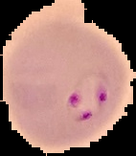
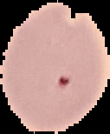
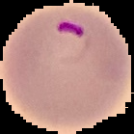
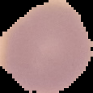
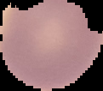
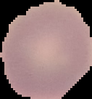
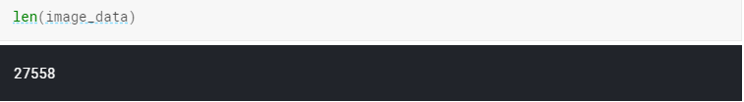
Image Classification Problem
Parasitized
Uninfected
Size of dataset:
Classification problem which has only two different classes to predict.

Slide 4
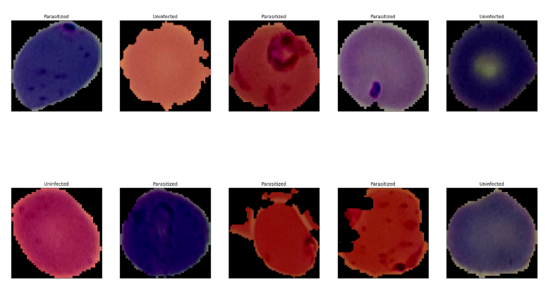
Each image size is different from each other therefore all the images are converted to the size of 150*150 and normalized with a mean and standard deviation of 0.5
Images after applying transformations.

Slide 5
Modelling Techniques used
Since it is a classification problem and we know that convolution neural networks are the best networks for image classification and image processing. We tried to use few CNN using the following architectures.
1) Customized CNN using random architecture with Drop-out, Adam's optimization and without dropout and SGD.
2) Pre-trained VGG model
3) Pre-trained model RESNET-18

Slide 6
VGG NET(Karen Simonyan & Andrew Zisserman)
The word VGG(Visual GEOMETRY GROUP) comes from the team headed by Andrew Zisserman at the “University of Oxford”.
VGG is basically a simplified and a better version of Alex Net.
The main aim of the VGG was to simplify the network, by only using 3*3 Kernel Size, Stride 1, and Padding the ‘same’.
For max pooling kernel size 2*2 and we use stride value 2.
Variants:
VGG – 16
VGG – 19
In VGG – 16 there are total of 16 layers, in VGG – 19 there are a total of 19 layers.

Slide 7
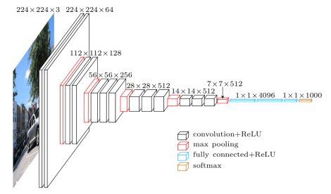
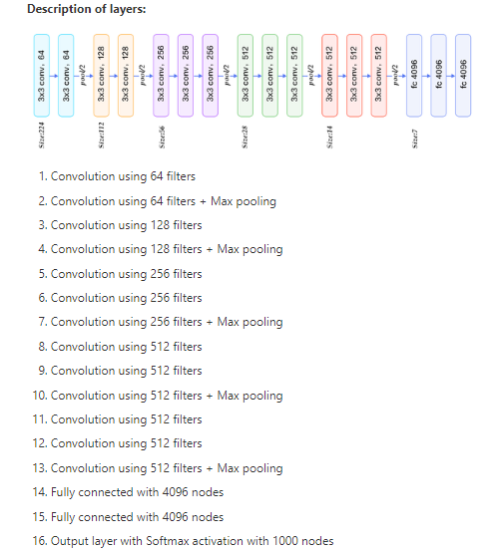
Full View at an Image Level. 224X224X3 224X224X64 112X112X128 56X56X256 28X28X512 14X14X512 7X7X512 Flatten with 4096 nodes.
Example of VGG 16 All the convolutions kernel size are of size 3*3, stride 1, padding same and all max pool have kernel size of 2*2, stride 2. Therefore Simplifying the model.

Slide 8
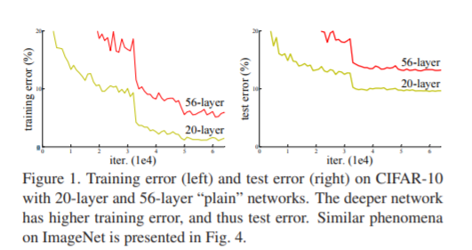
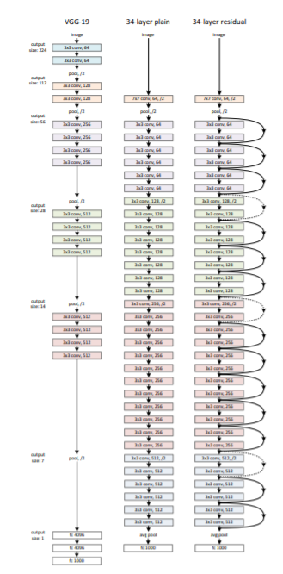
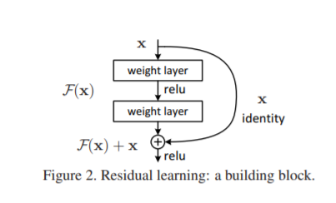
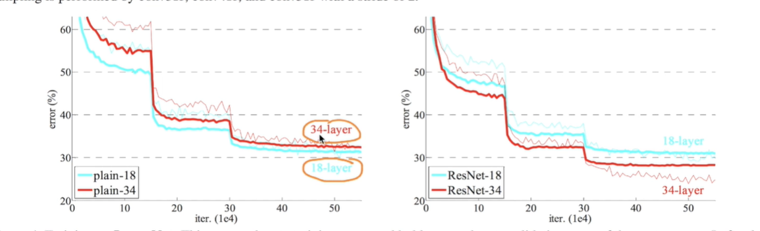
RESNET (Deep Residual Learning for Image Recognition)
In plain N/w, the training, testing error after a time was increasing rapidly even after using RELU, Dropouts, etc. and so on..
Then comes the concept of Residual Networks(Skip Connection) acting as an identity Block.
The output of a previous layers is added to the output function F(x) before applying RELU, which acts as an Identity function (F(x)=x))
If F(x)=0, then F(x)+x = x, that means if there is a strong regularizer where it makes all the convolutions/Weight Layers 0, and which are of no use then we can skip those. If they have some value, they will increase the performance.

Slide 9
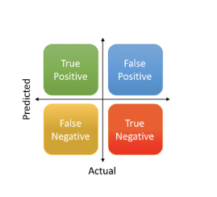
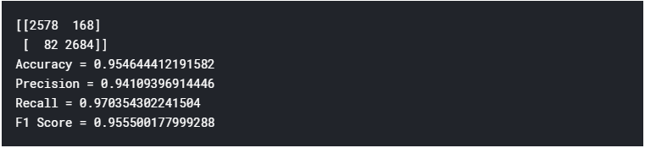
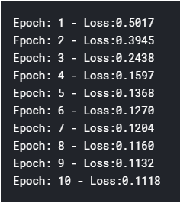
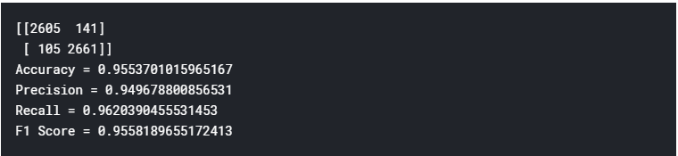
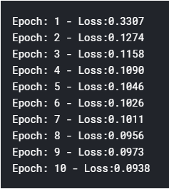
Results
Customized CNN with 16,32,64 & 128 filters, Re-LU activation and batch Normalization:
Without dropout using SGD and learning rate of 0.001:
With dropout and Adams optimization using same learning rate:
Train loss
Train loss

Slide 10
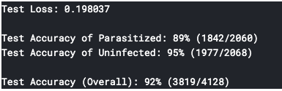
VGG Results
With dropout and SGD optimization using same learning rate:

Slide 11
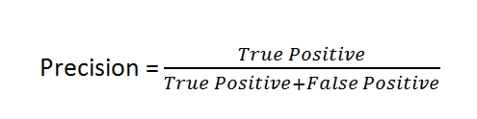
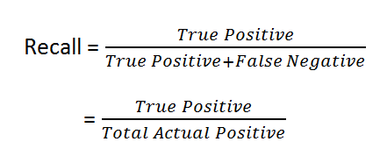
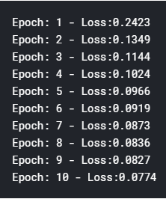
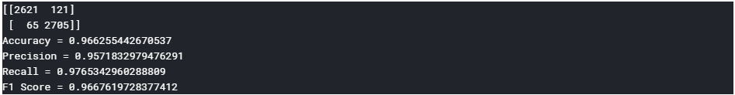
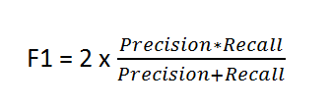
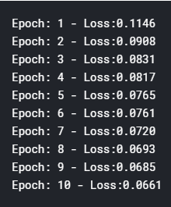
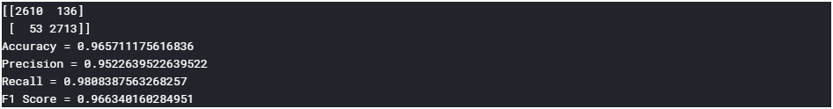
Resnet-18 with sgd:
Train loss
Resnet-18 with adam’s optimization:
Train loss

Slide 12
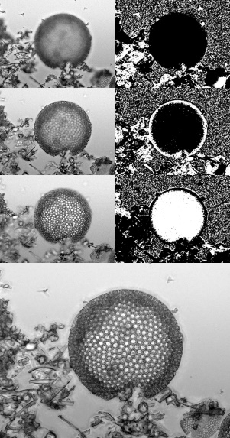
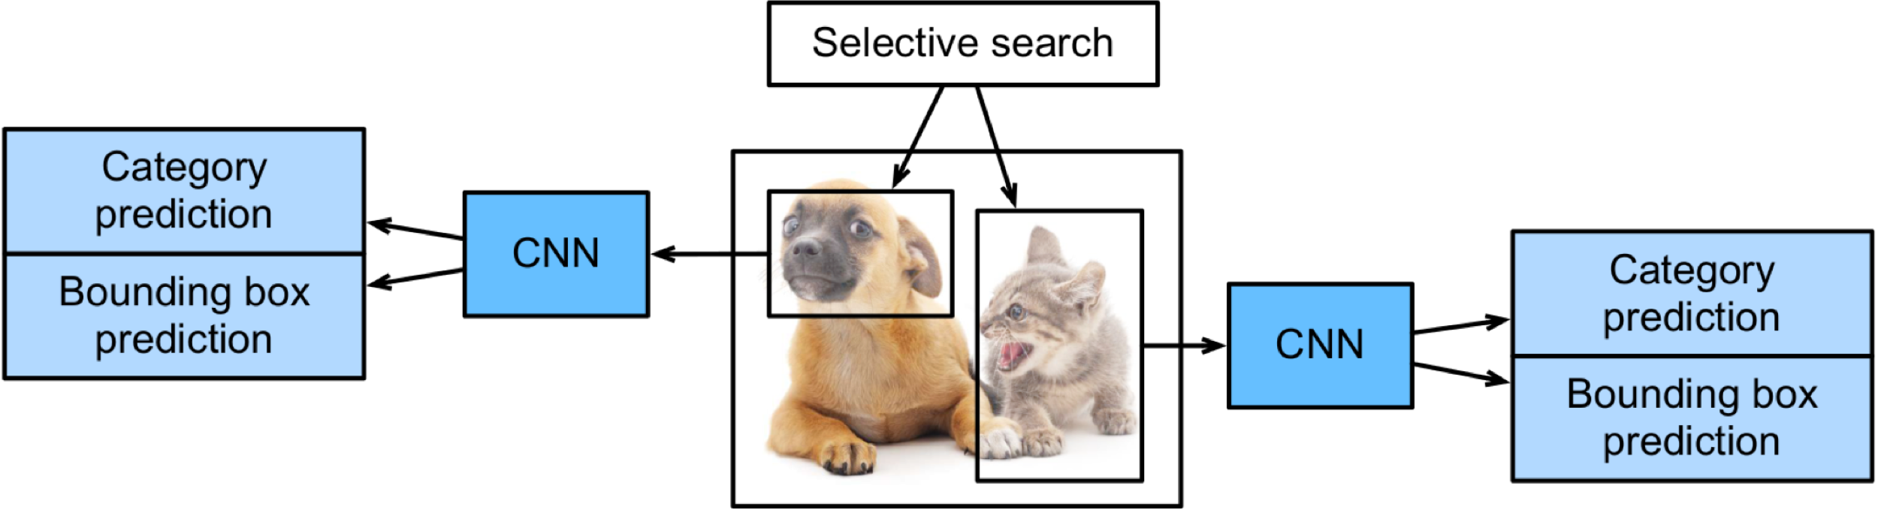
Other Techniques
Focus stacking :
Is a digital image processing technique which combines multiple images taken at different focus
distances to give a resulting image with a greater depth of field (dof) than any of the individual
source images.
Region-based convolution neural network :
R-CNN models first select several proposed regions from an image and label their categories then, they use a CNN to perform forward computation to extract features from each proposed area. This features of each proposed region are used predict their categories.

Slide 13

Questions?

